Slide 1
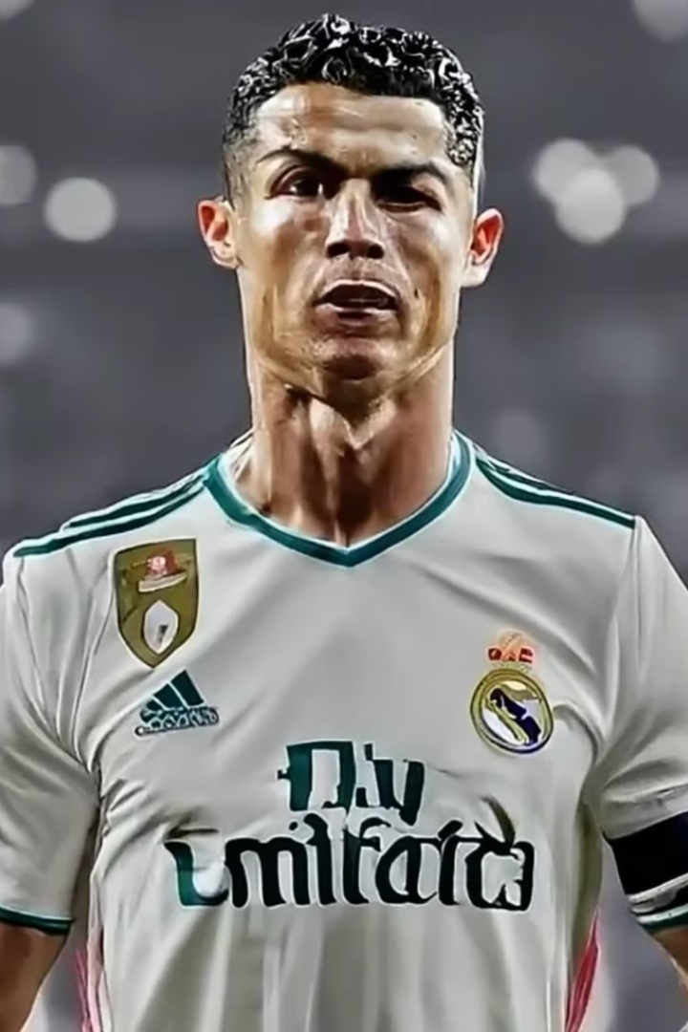
SportswearXpress
AI-Enhanced Sportswear Customization Platform
SportWearXpress

Slide 2

Presented by
Awais Akram
Qasim Abbas
Muneeb Butt
L1S21BSSE0072
L1F21BSSE0476
L1F21BSSE0564
SportWearXpress

Slide 3
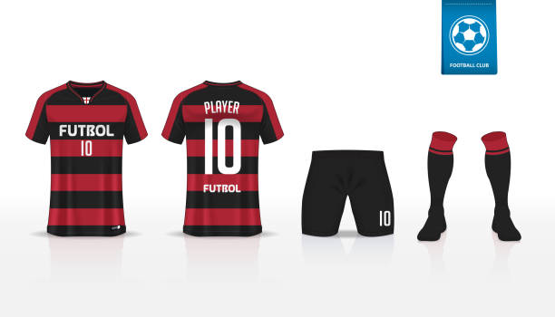
INTRODUCTION
SportswearXpress is an AI-driven e-commerce platform designed to enhance sportswear customization. It integrates AI-powered design tools, dynamic pricing, and real-time communication to streamline the process. Traditional platforms lack intelligent guidance, leading to errors and inefficiencies. Our platform provides precise customization, instant pricing updates, and seamless interaction between buyers and sellers, ensuring a better user experience
SportWearXpress

Slide 4
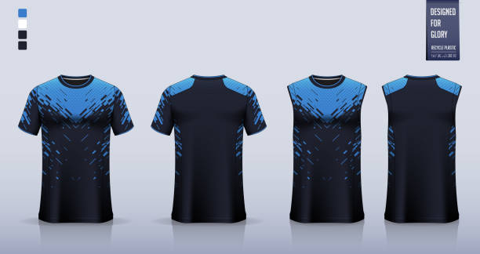
PROBLEM STATEMENT
Existing sportswear customization platforms lack AI-powered tools, dynamic pricing, and real-time communication, leading to inefficiencies and poor user experience. Customers struggle with inaccurate designs, unpredictable costs, and miscommunication with sellers. SportswearXpress solves these issues by offering intelligent design assistance, automated pricing based on complexity, and seamless buyer-seller interaction.
SportWearXpress

Slide 5
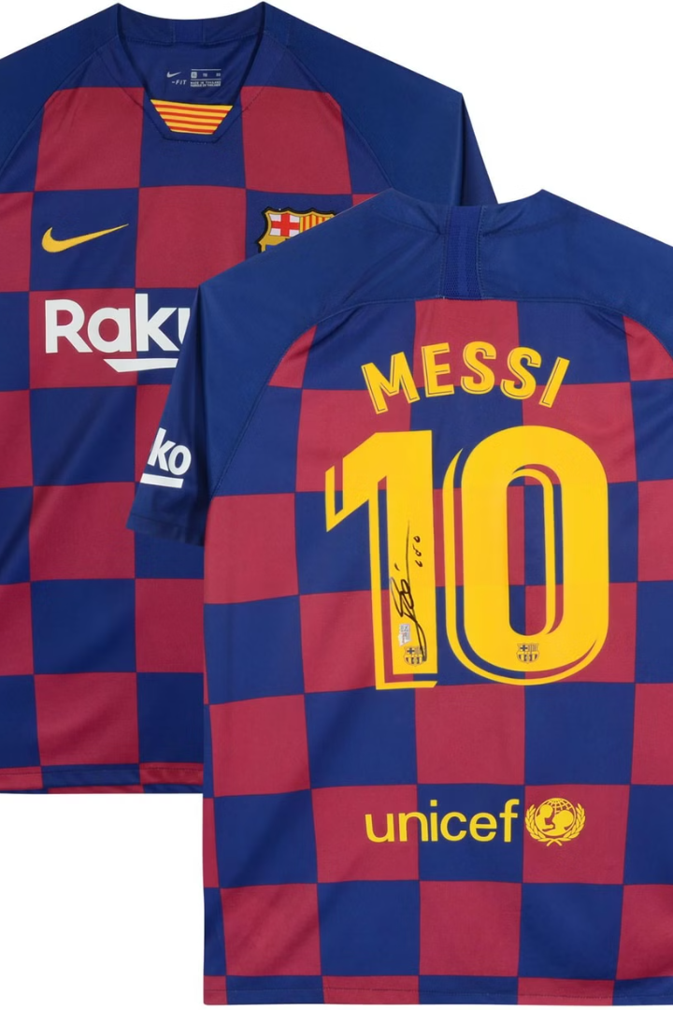
PURPOSE AND OBJECTIVES
Purpose: SportswearXpress aims to revolutionize sportswear customization by integrating AI-driven design tools, real-time communication, and dynamic pricing. The platform enhances user experience by providing precise design assistance, seamless interaction between buyers and sellers, and automated pricing based on customization complexity. Our goal is to create a scalable, efficient, and user-friendly solution that sets a new standard in personalized sportswear shopping
SportWearXpress

Slide 6
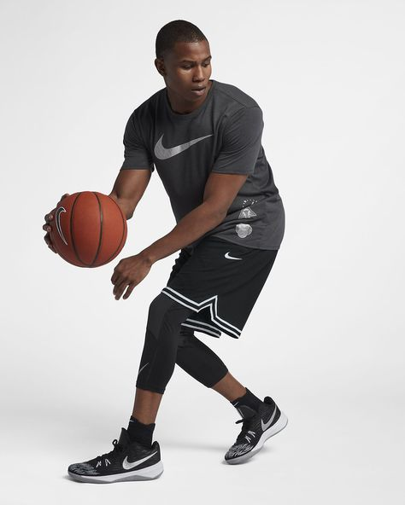
OBJECTIVES
1
AI-powered design assistance for precise customization
2
Dynamic pricing based on design complexity
Real-time communication
between
buyers and sellers
Increase Customer
Satisfaction
3
4
Reduce vendor
distraction
5
SportWearXpress

Slide 7
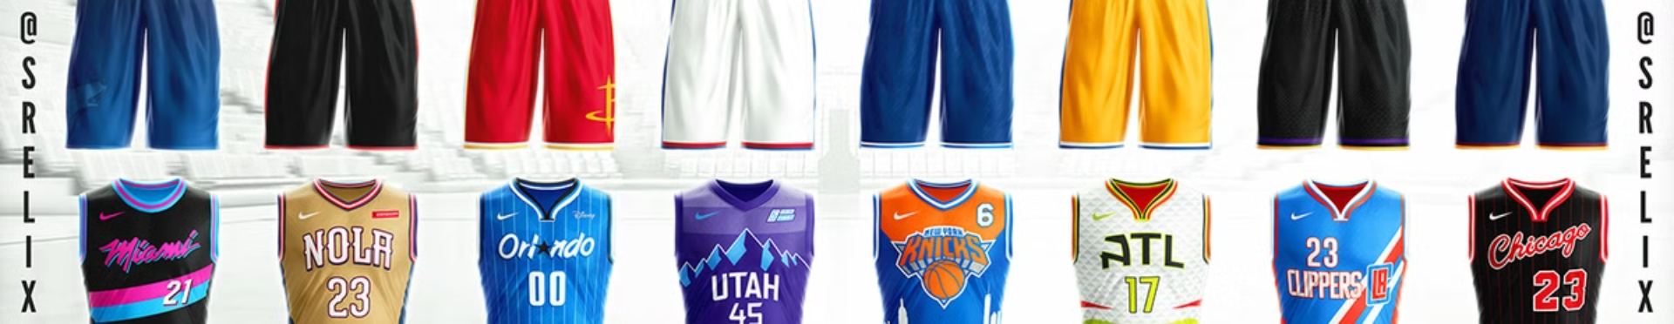
FEATURES
1) AI-Powered Design Tools
2) Real-Time Communication
3) AI-Powered Design Tools
4) Dedicated User Interfaces
5) Admin Dashboard & Analytics
SportWearXpress

Slide 8
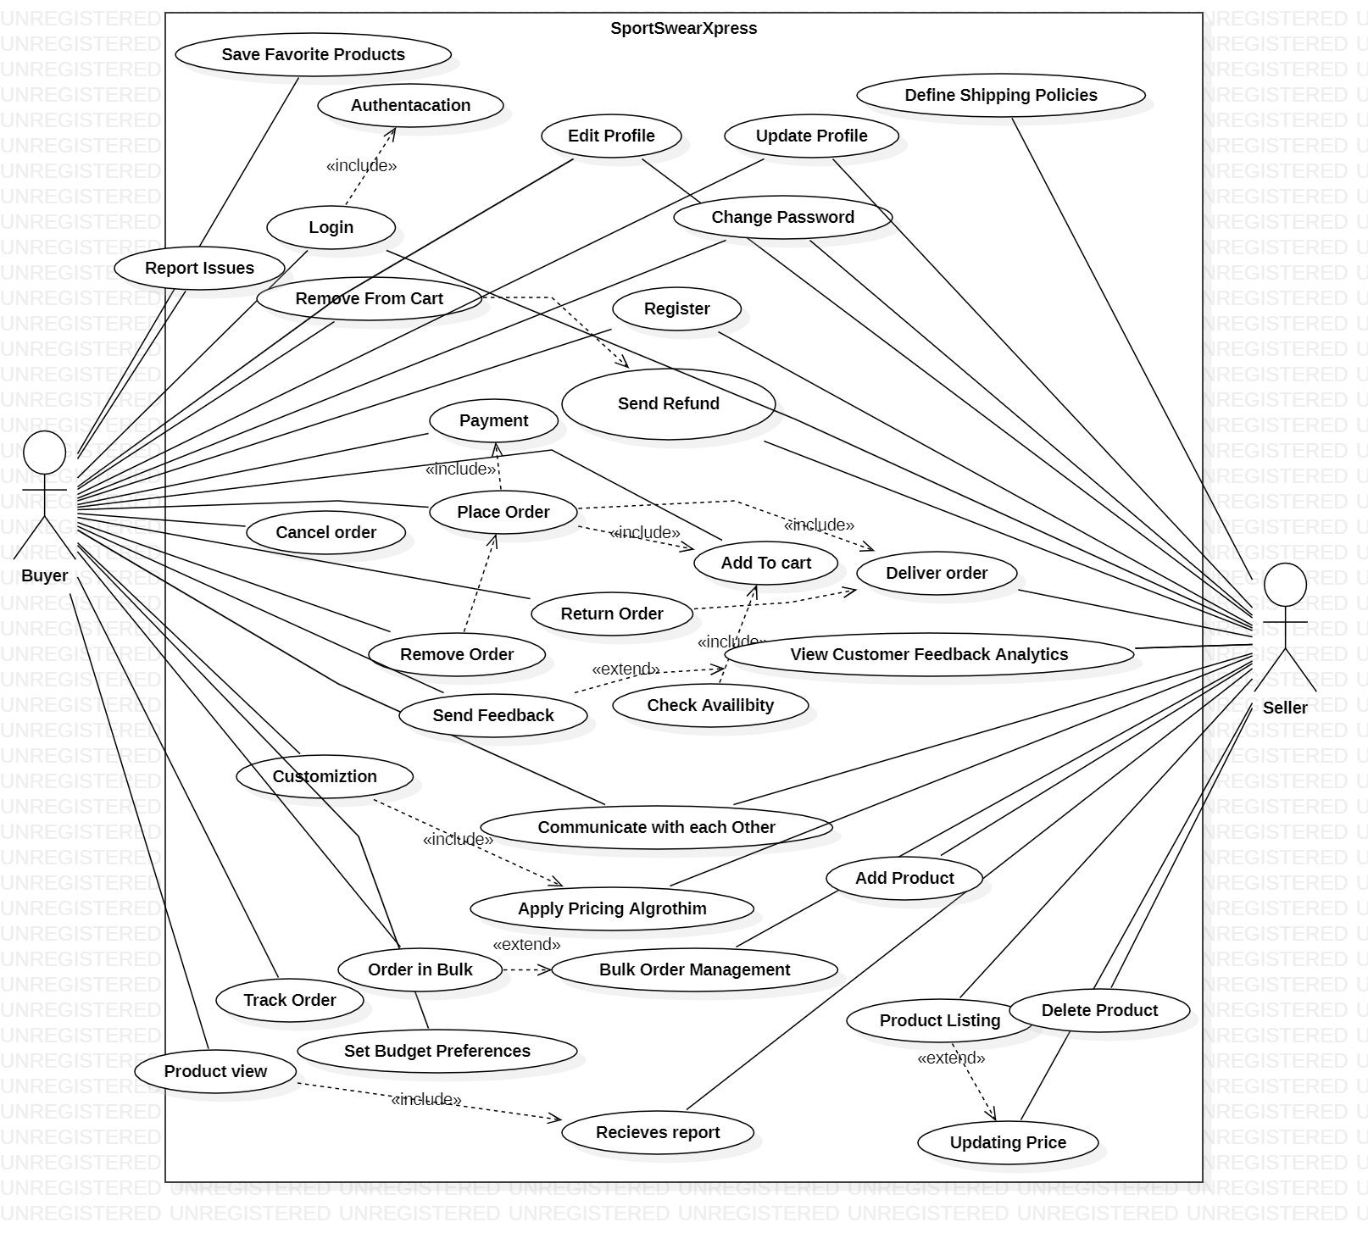
USECASE Diagram

Slide 9
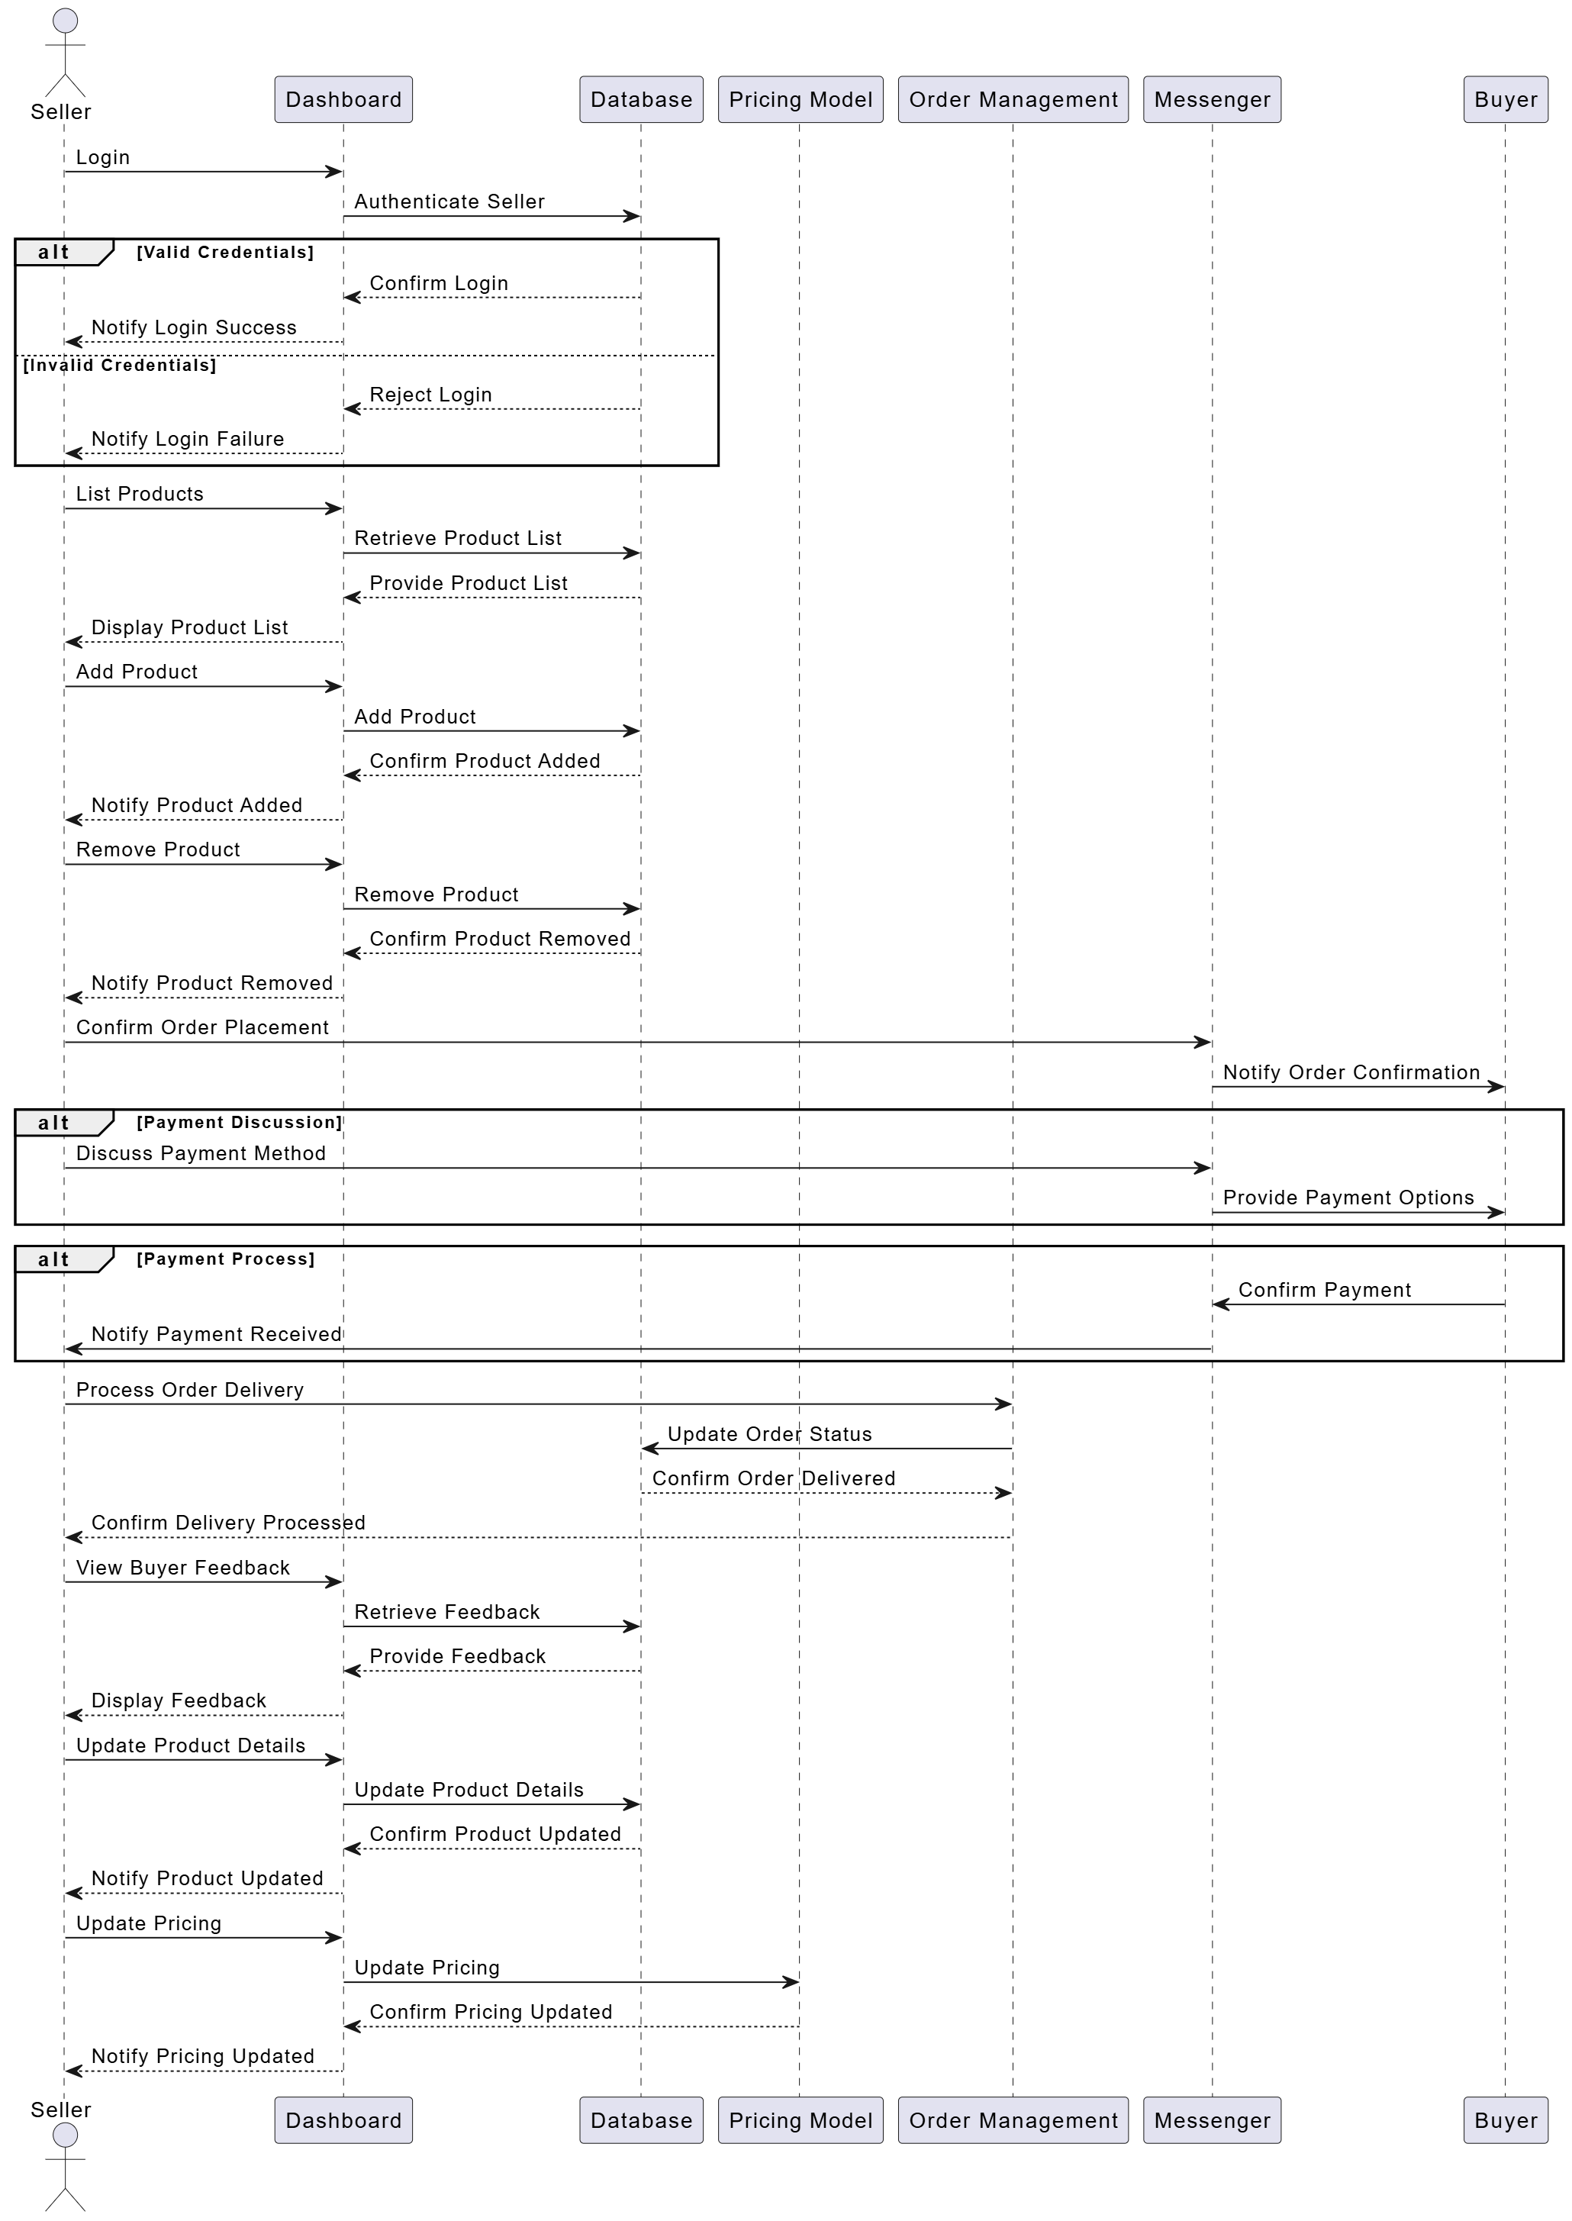
Sequence Diagram (Seller)

Slide 10
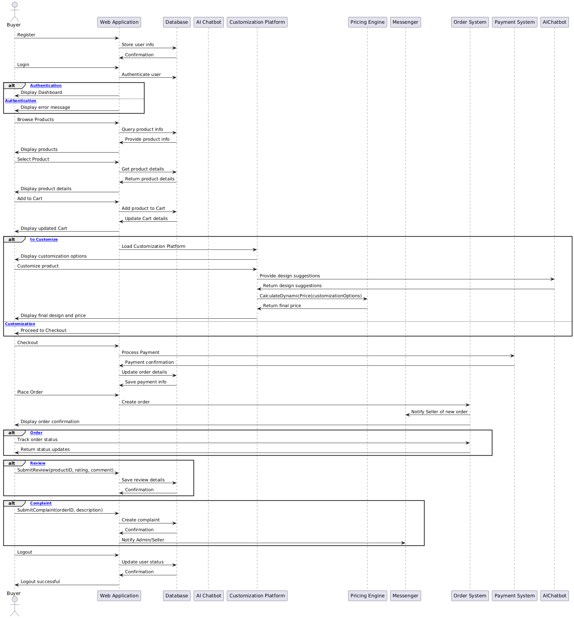
Sequence Diagram (Buyer)

Slide 11
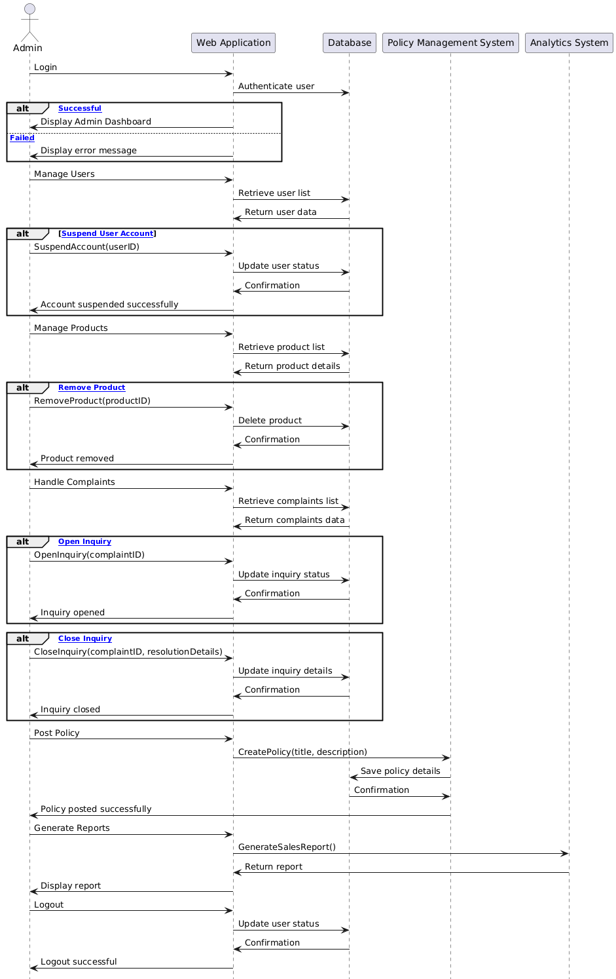
Sequence Diagram (ADMIN)

Slide 12
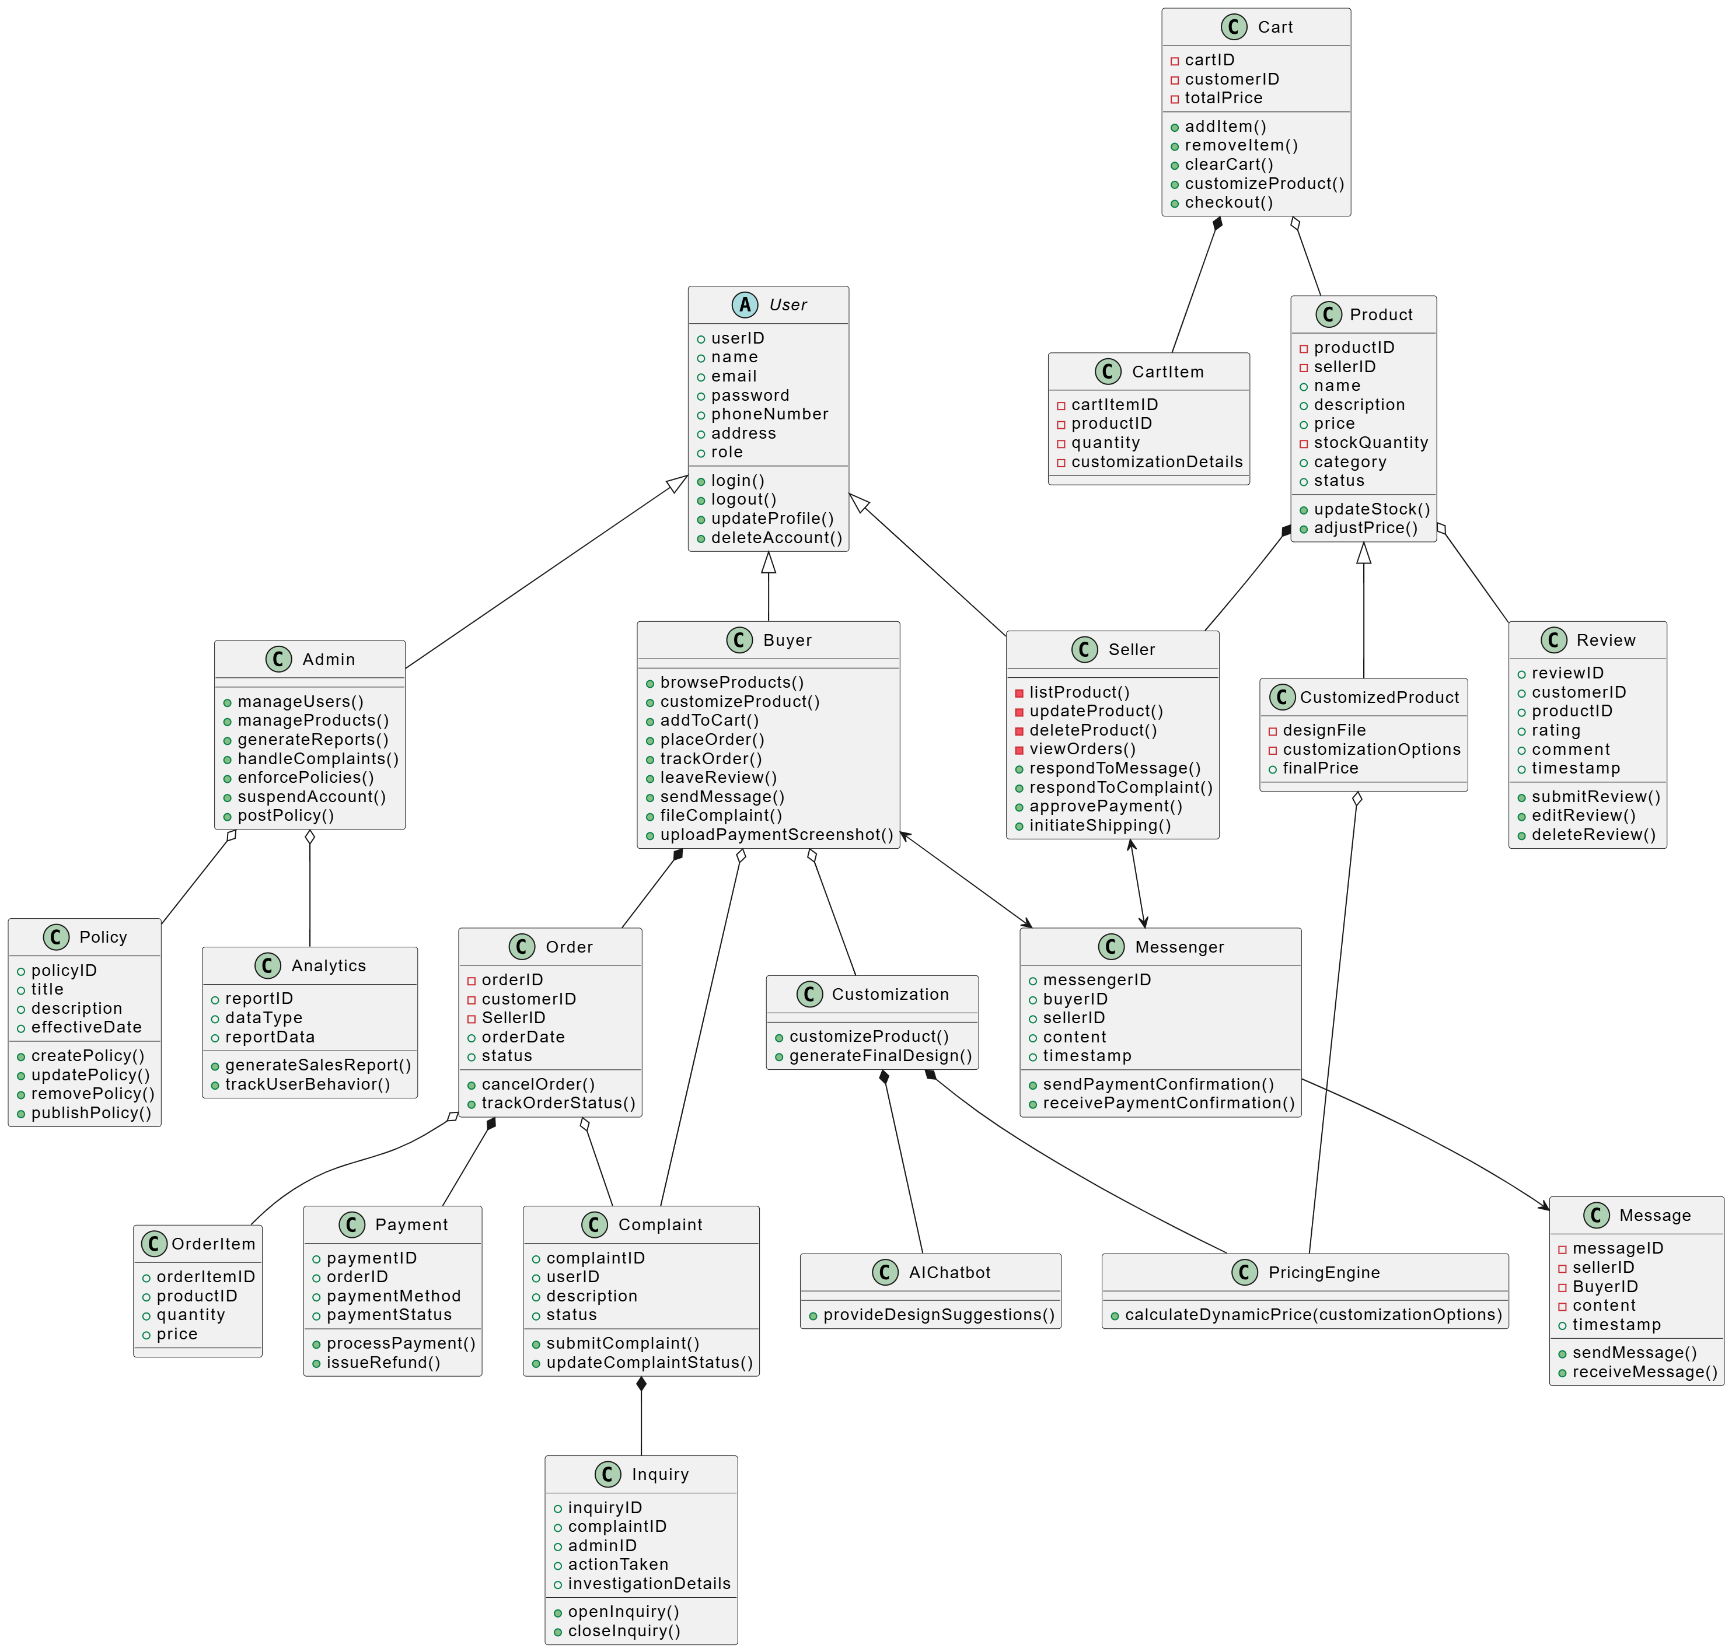
Class Diagram

Slide 13
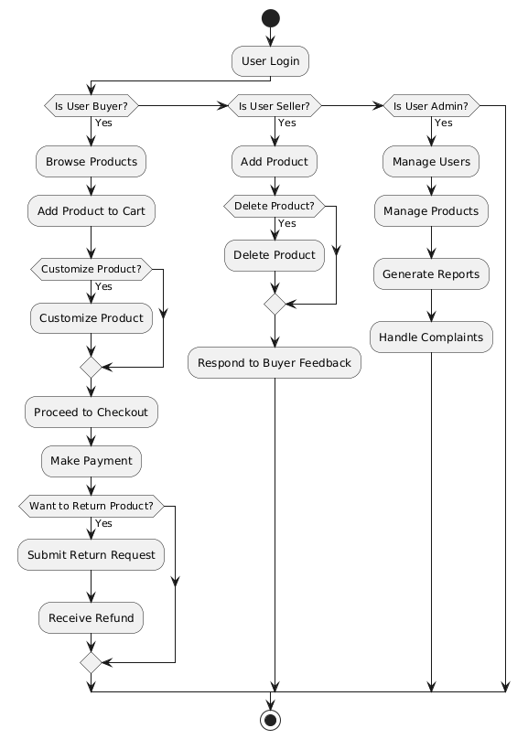
ACTIVITY Diagram

Slide 14
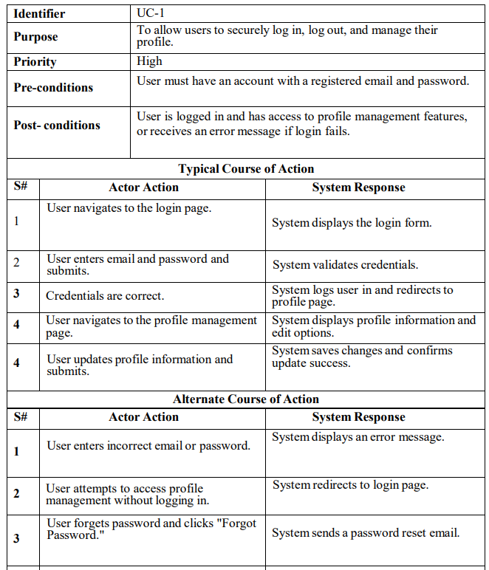
User Authentication and Profile Management

Slide 15
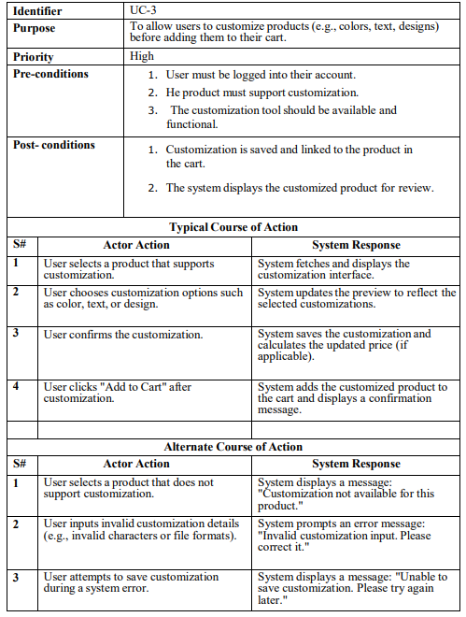
PRODUCT Customization

Slide 16
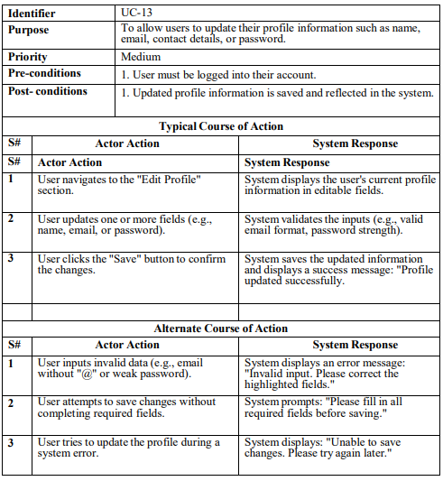
EDIT PROFILE

Slide 17
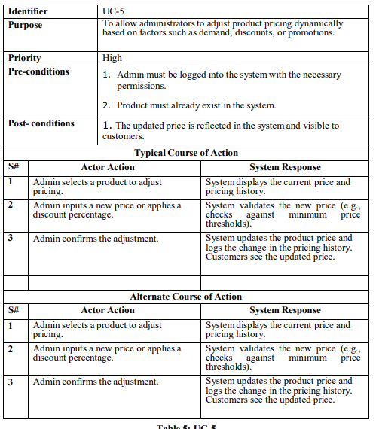
DYNAMIC PRICING

Slide 18
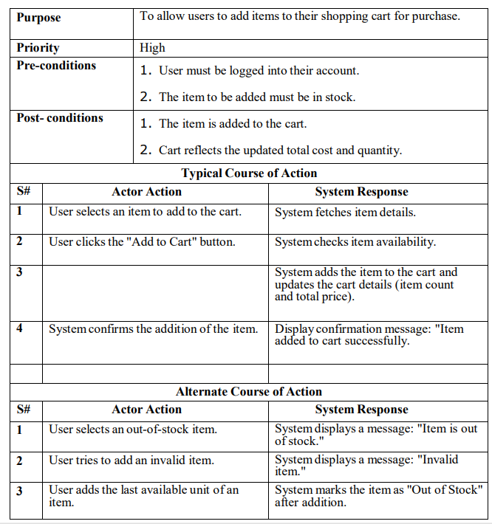
ADD CART

Slide 19
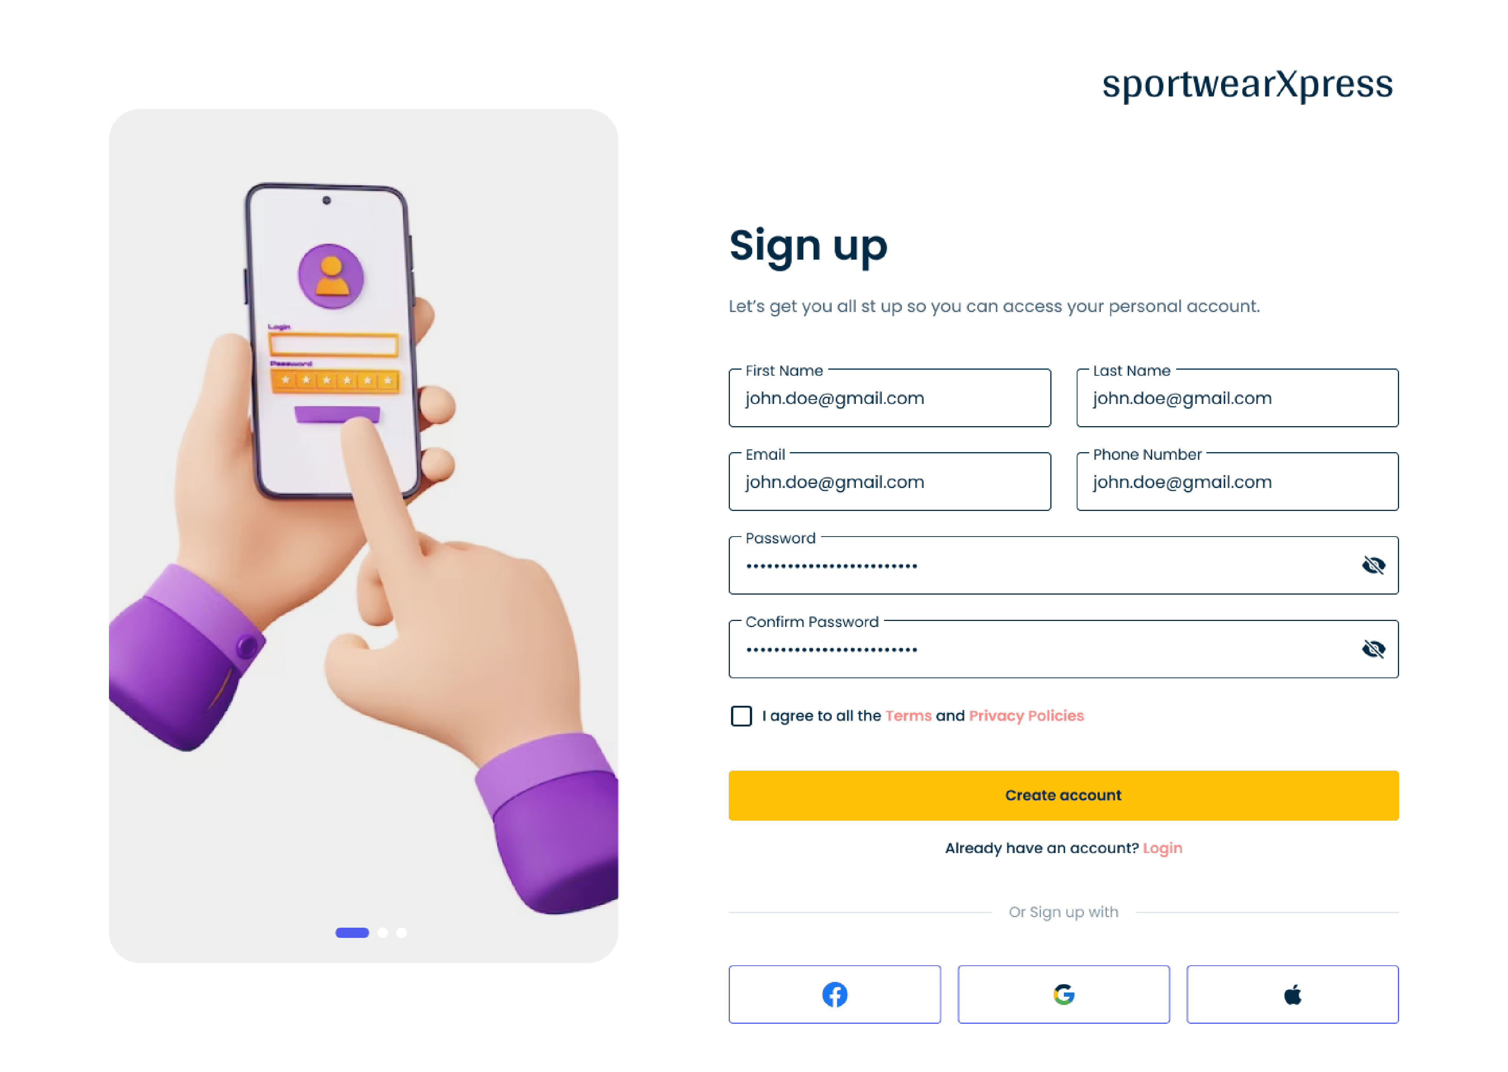
SIGN UP

Slide 20
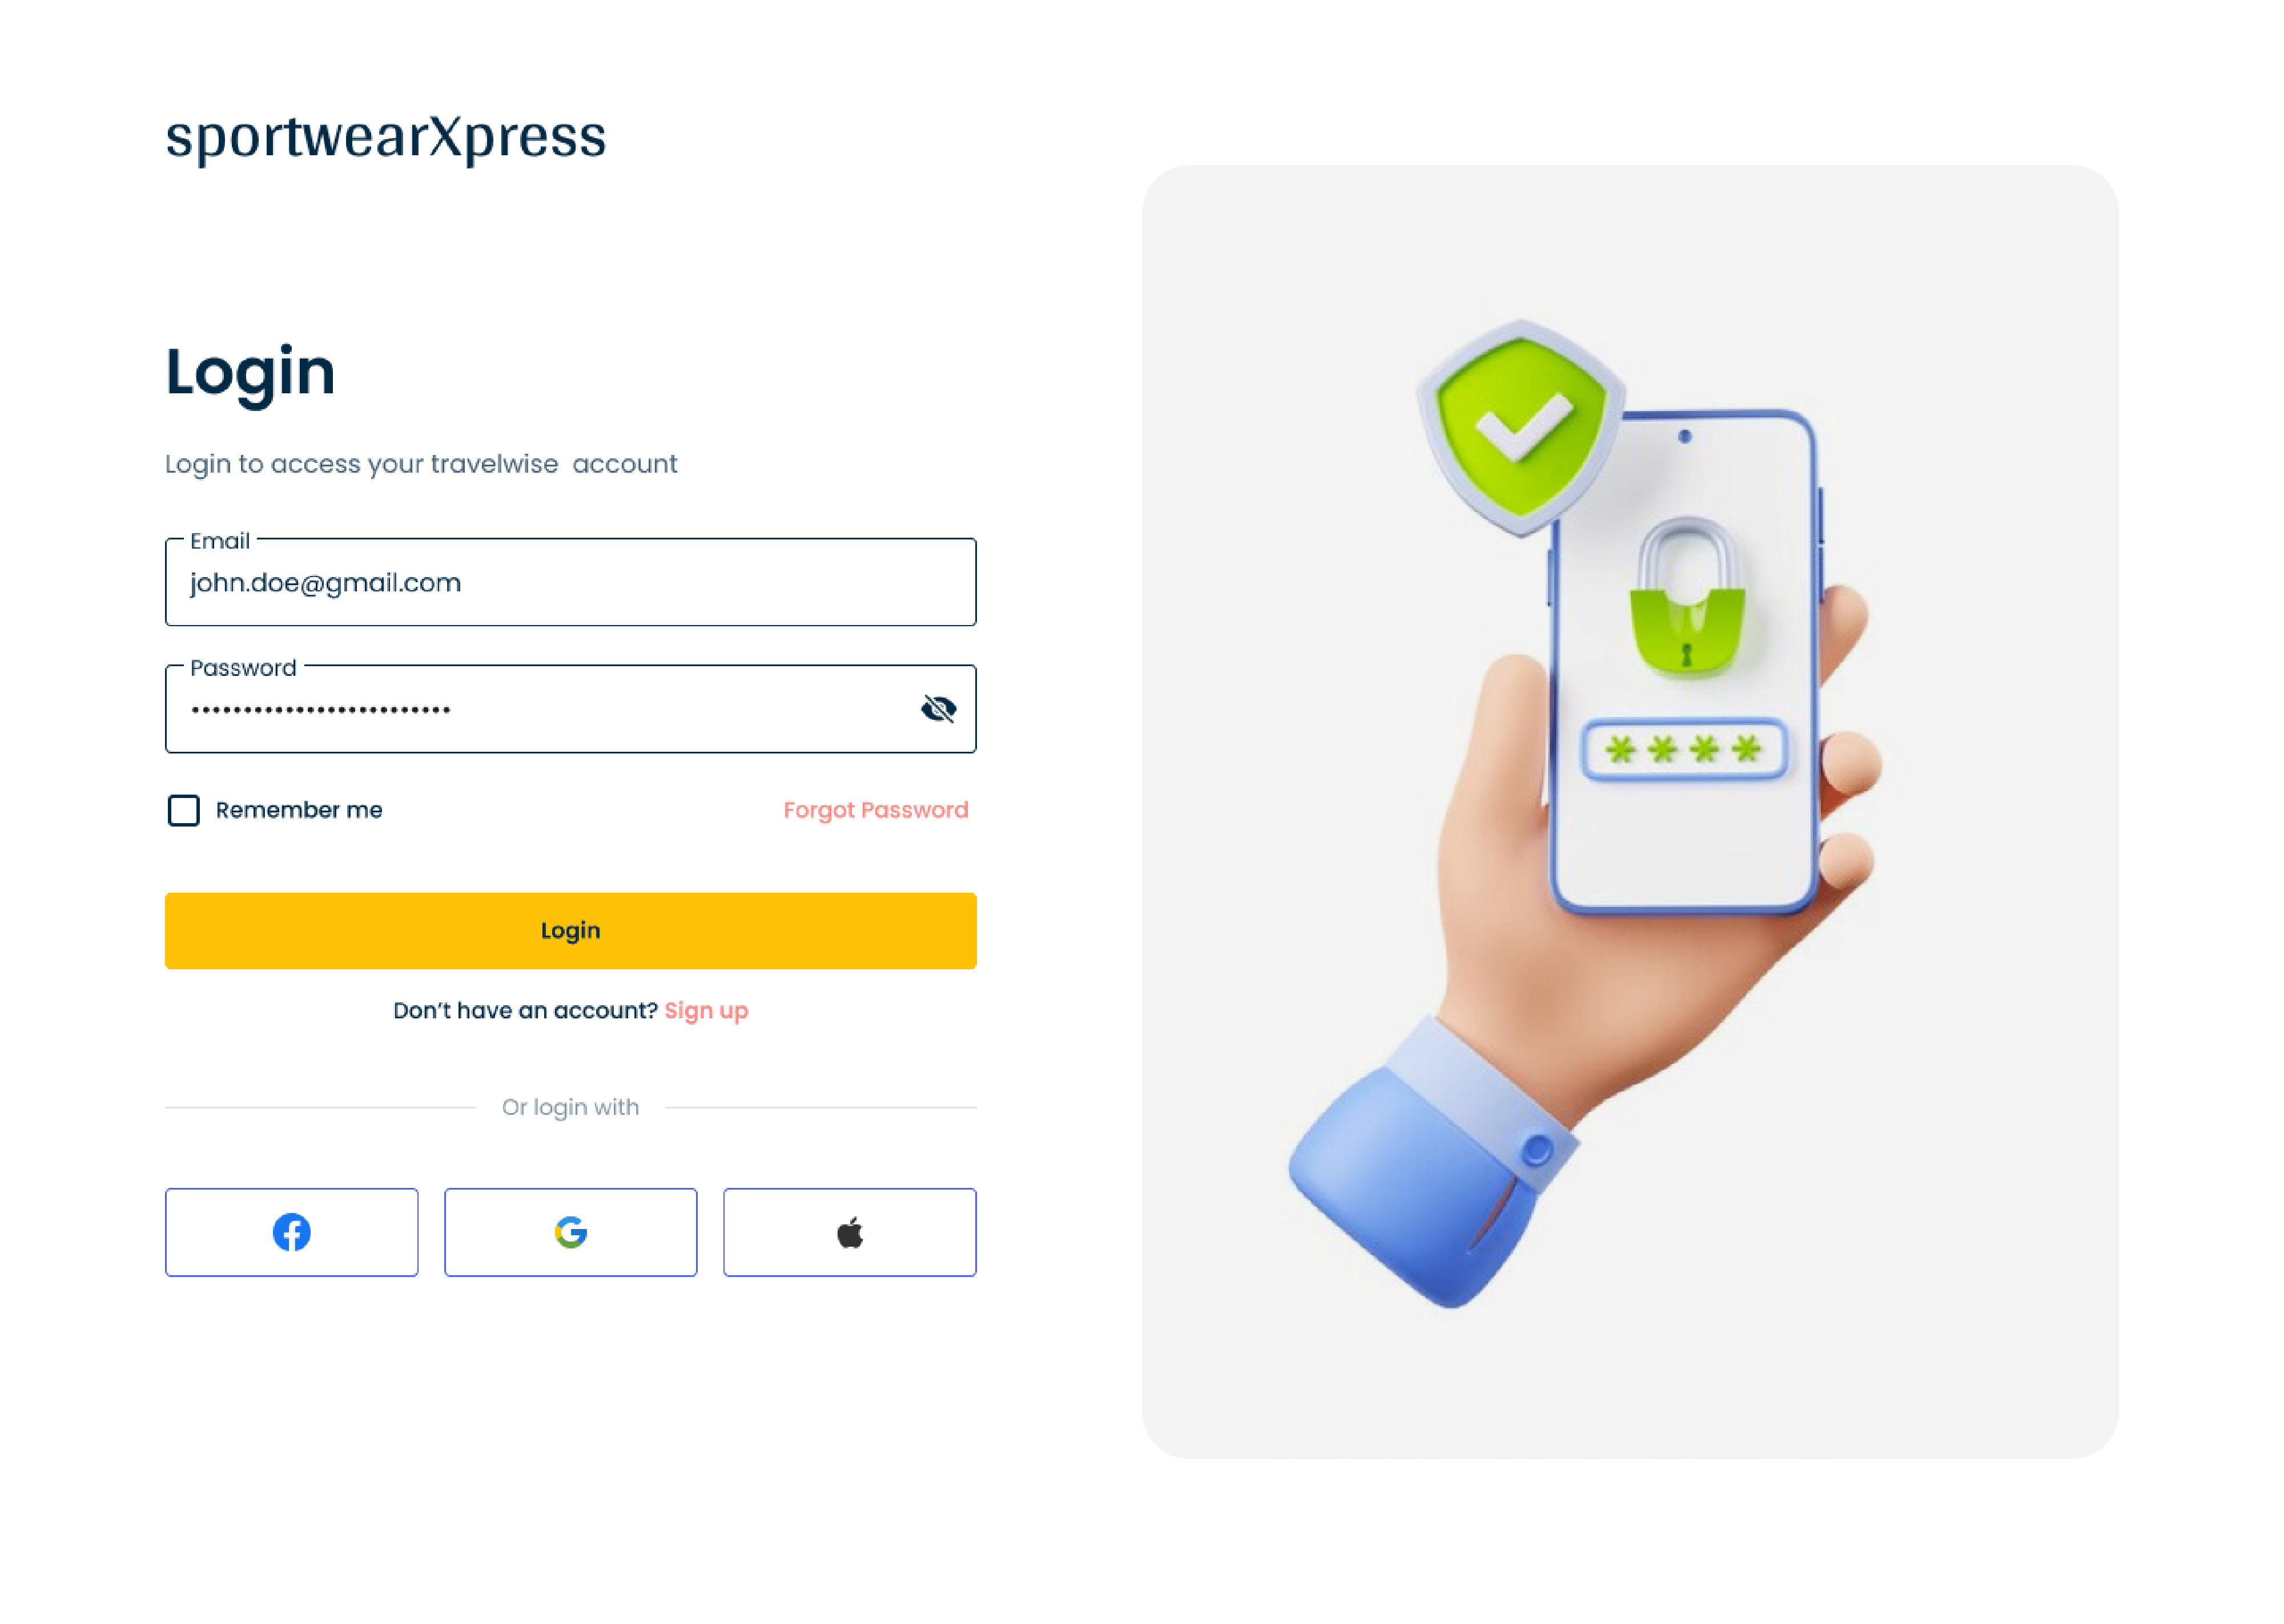
LOGIN

Slide 21
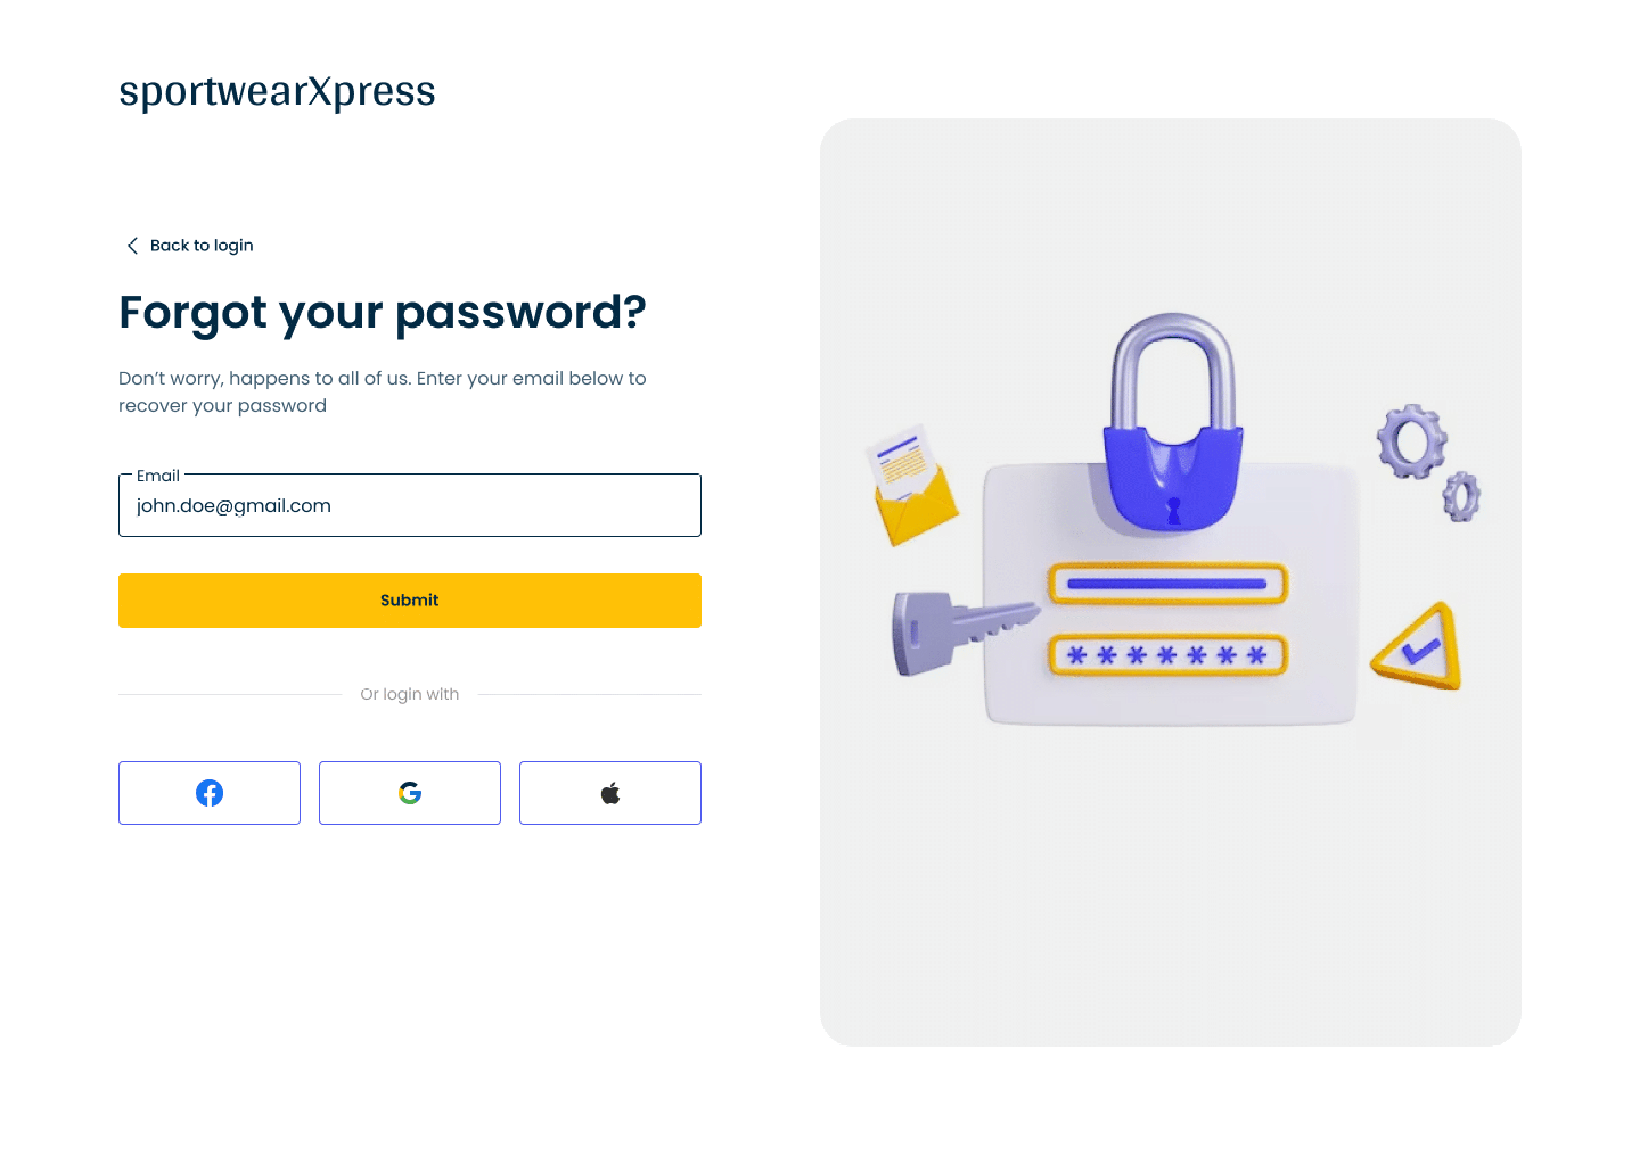
FORGET PASSWORD

Slide 22
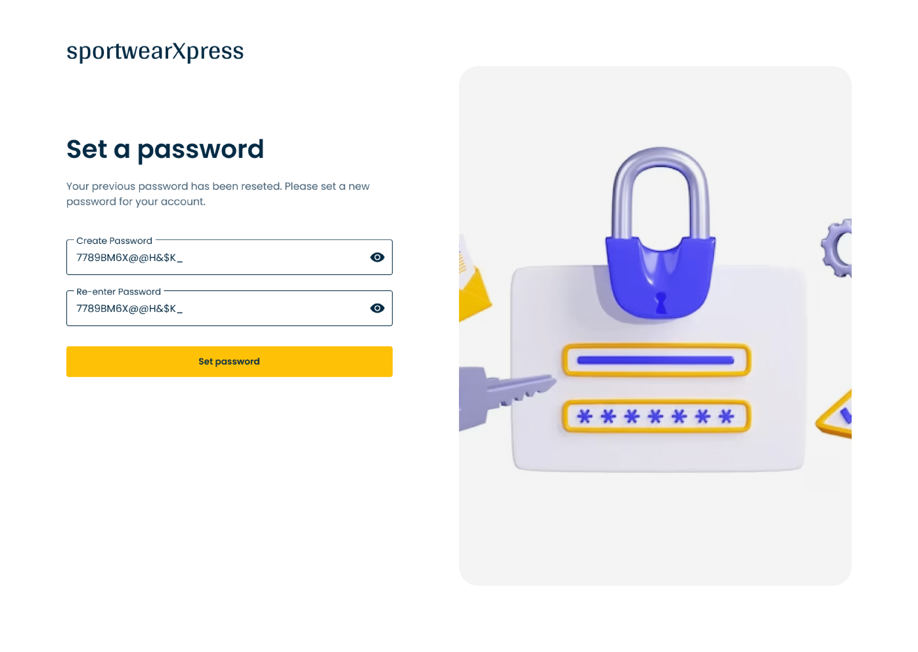
SET NEW PASSWORD

Slide 23
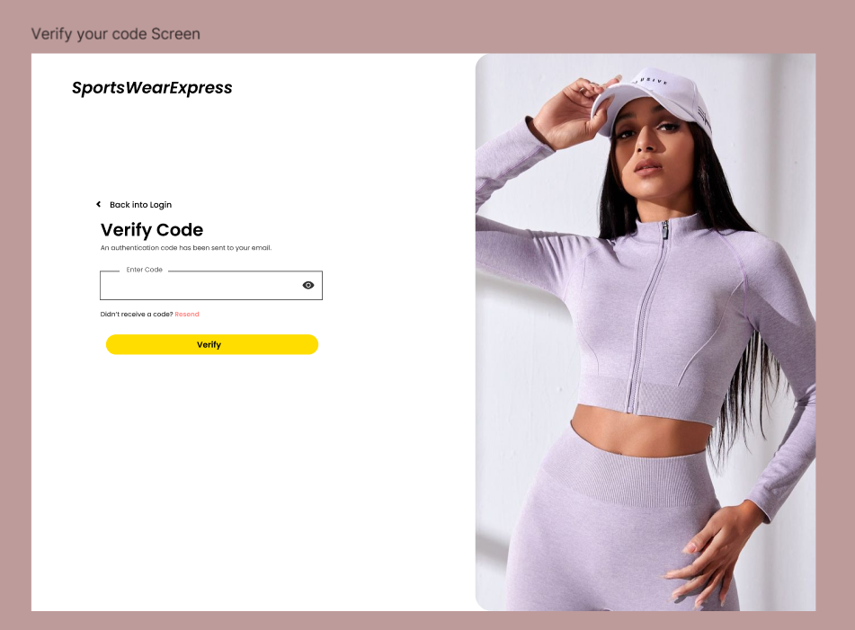
VERIFY PASSWORD

Slide 24
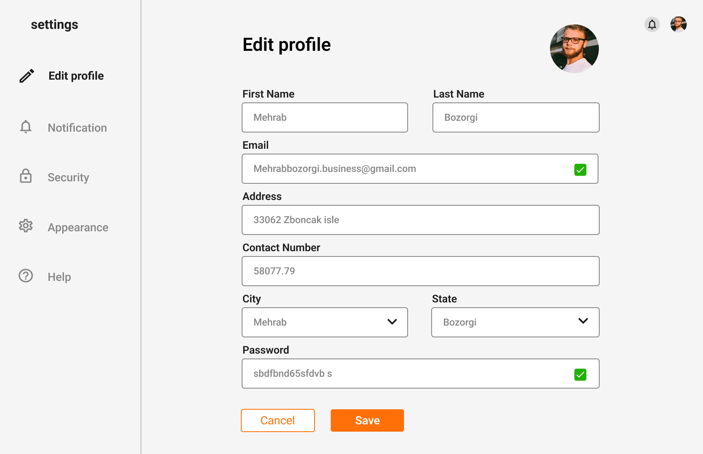
EDIT PROFILE

Slide 25
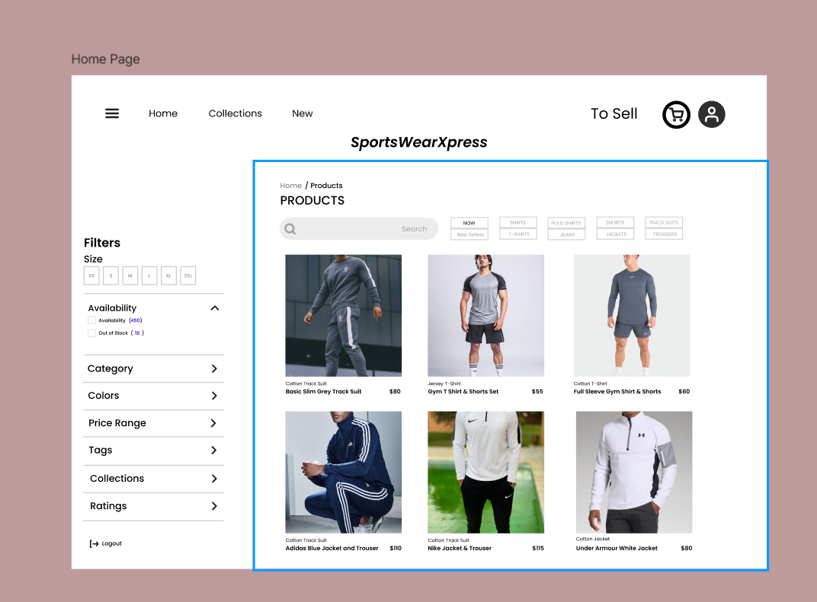
BUYER DASHBOARD

Slide 26
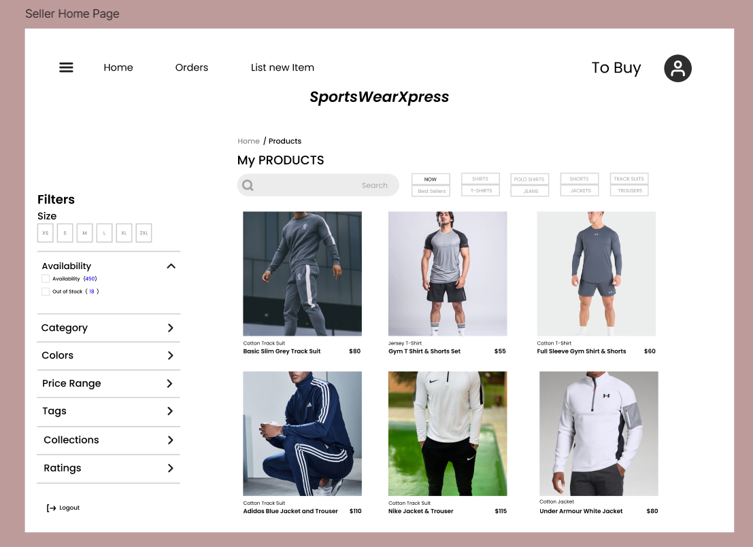
SELLER DASHBOARD

Slide 27
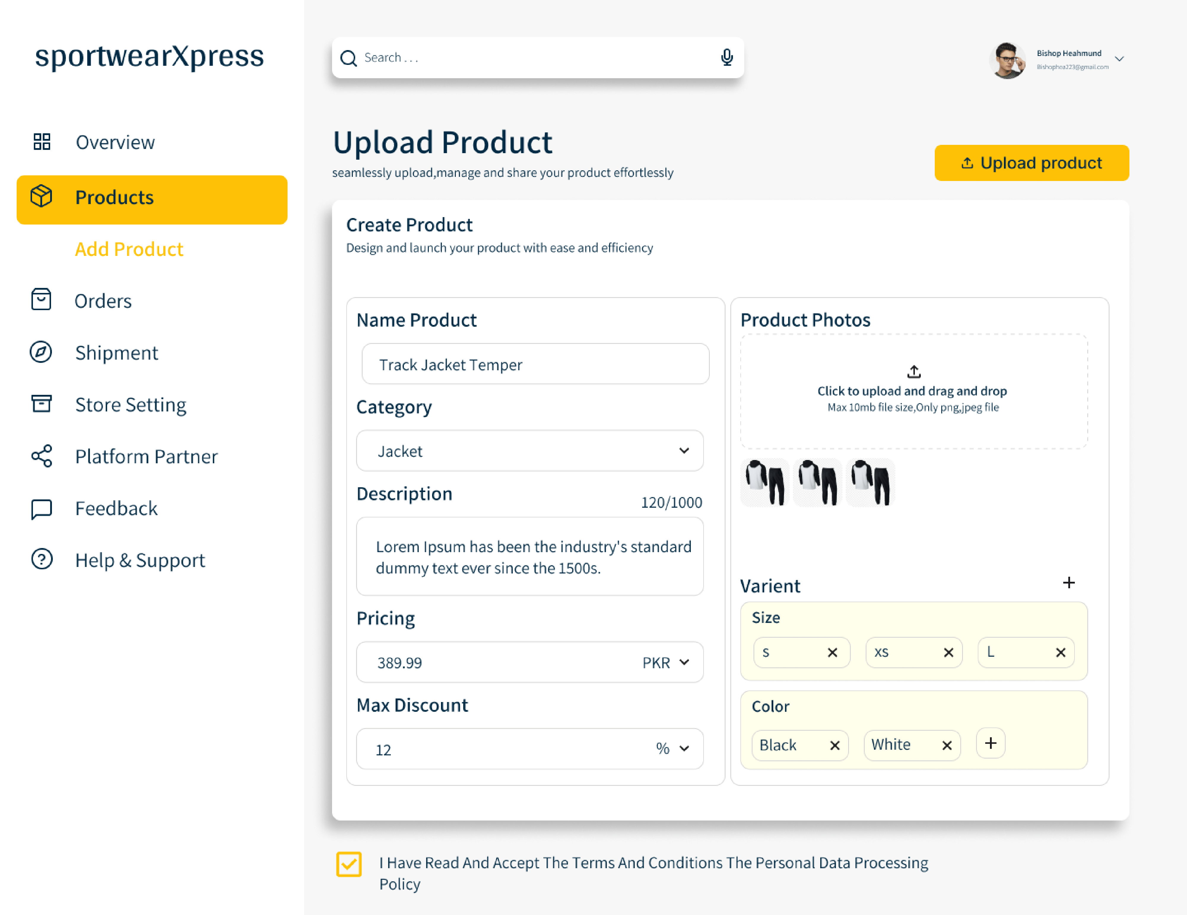
ADD PRODUCT

Slide 28
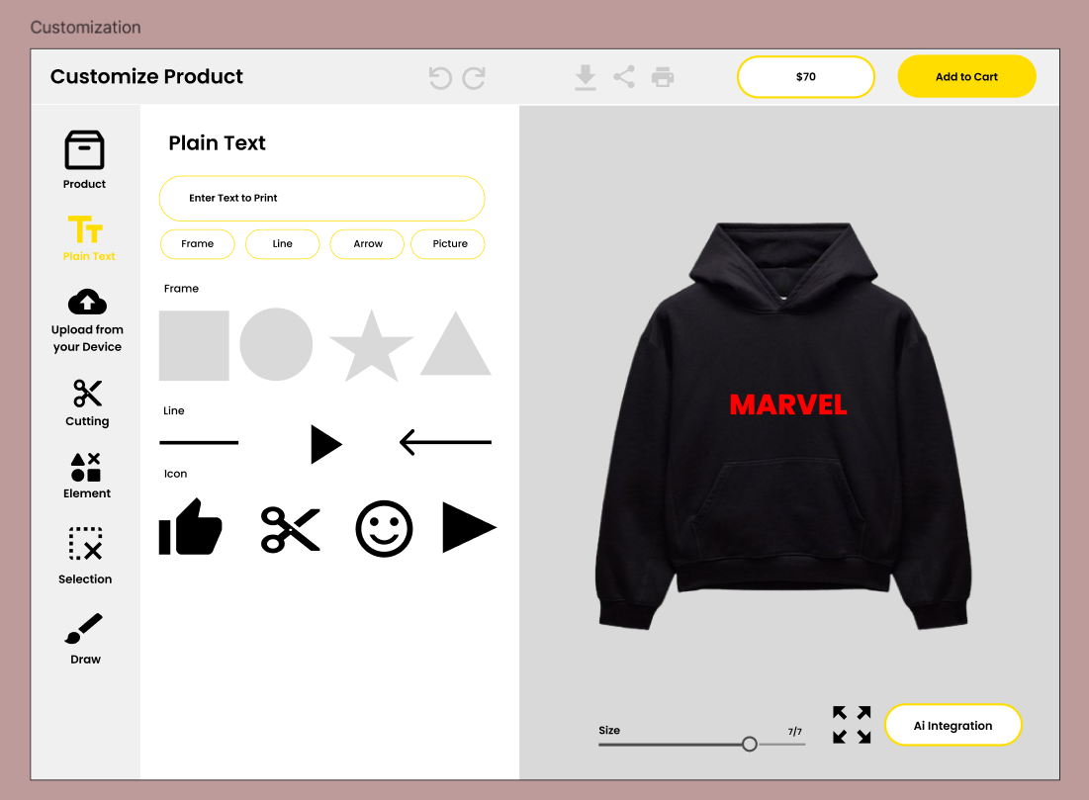
CUSTOMIZATION PRODUCT

Slide 29
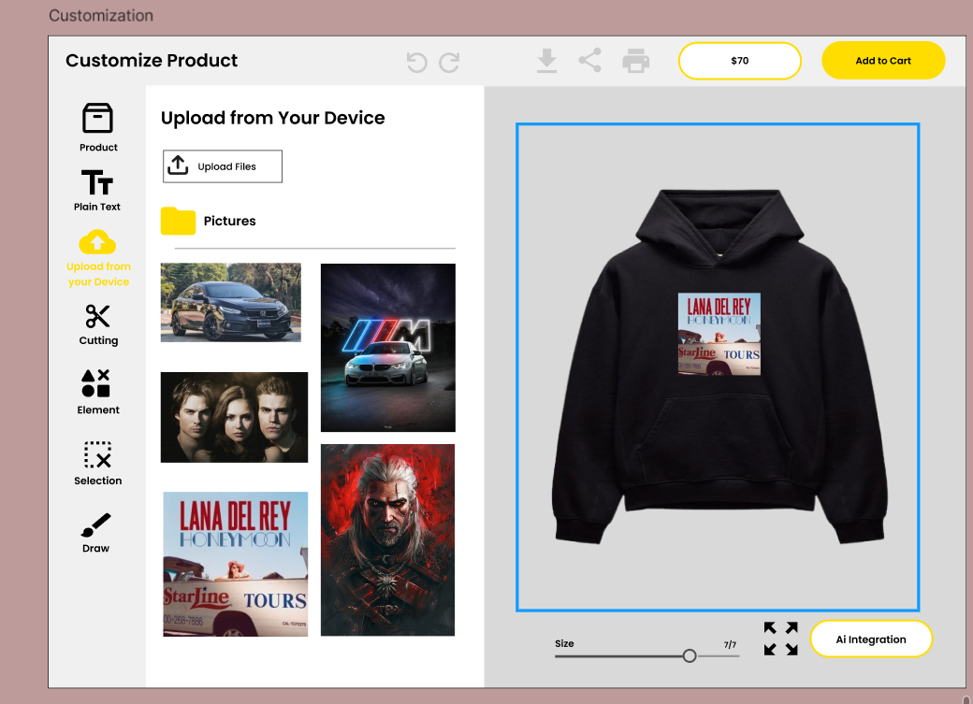
CUSTOMIZATION PRODUCT

Slide 30
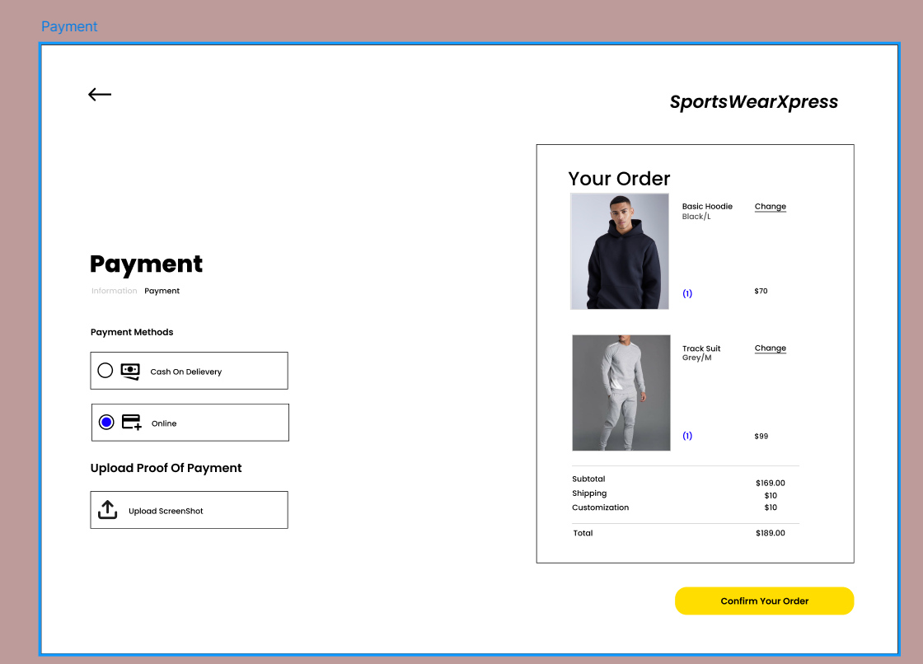
ORDER CONFIRMATION

Slide 31
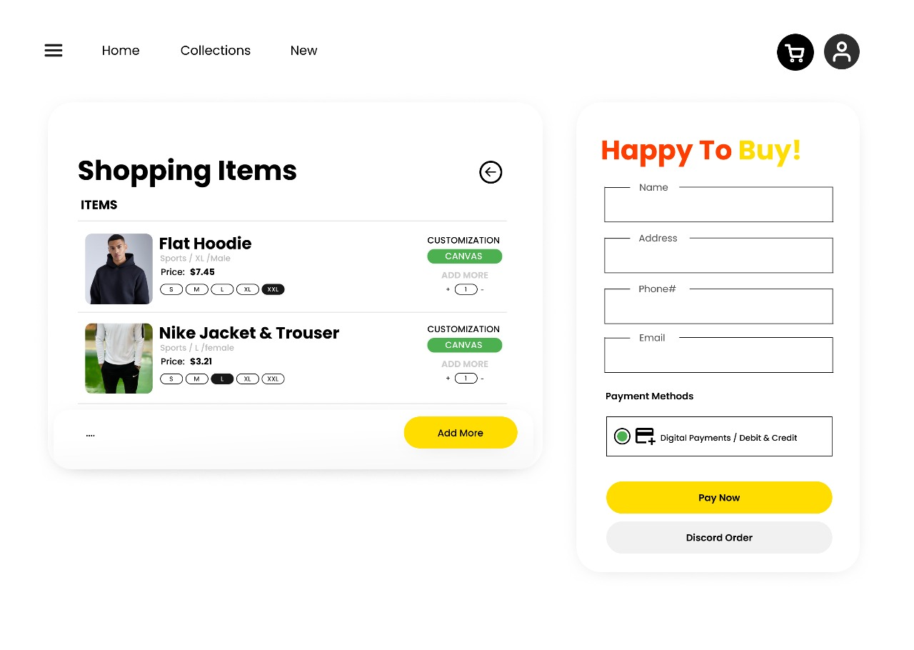
CART

Slide 32
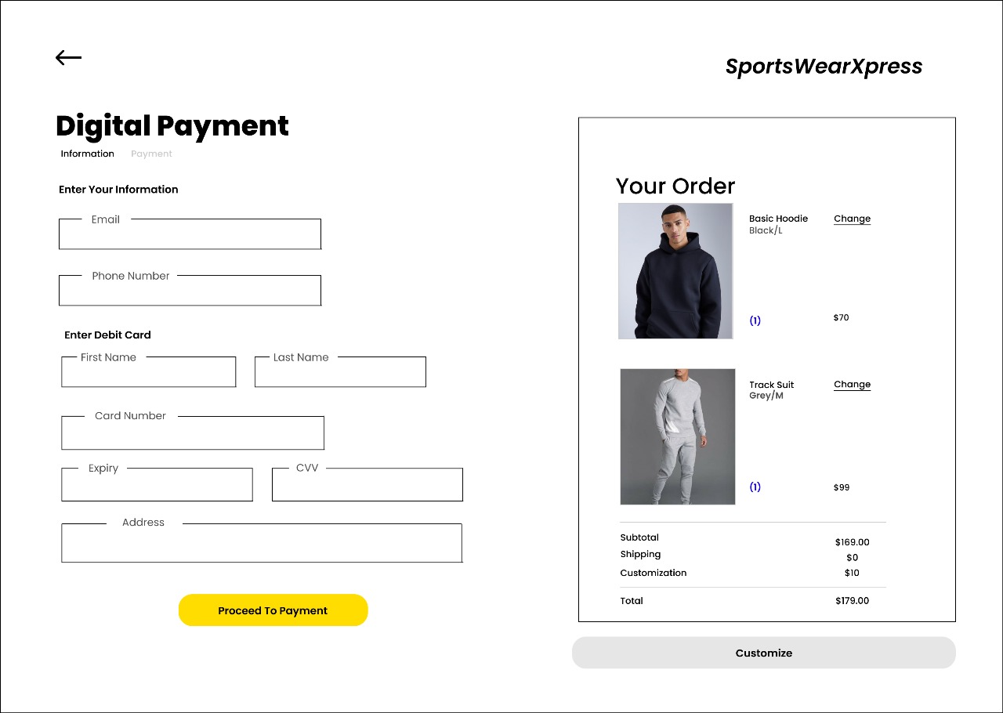
DIGITAL PAYMENT

Slide 33
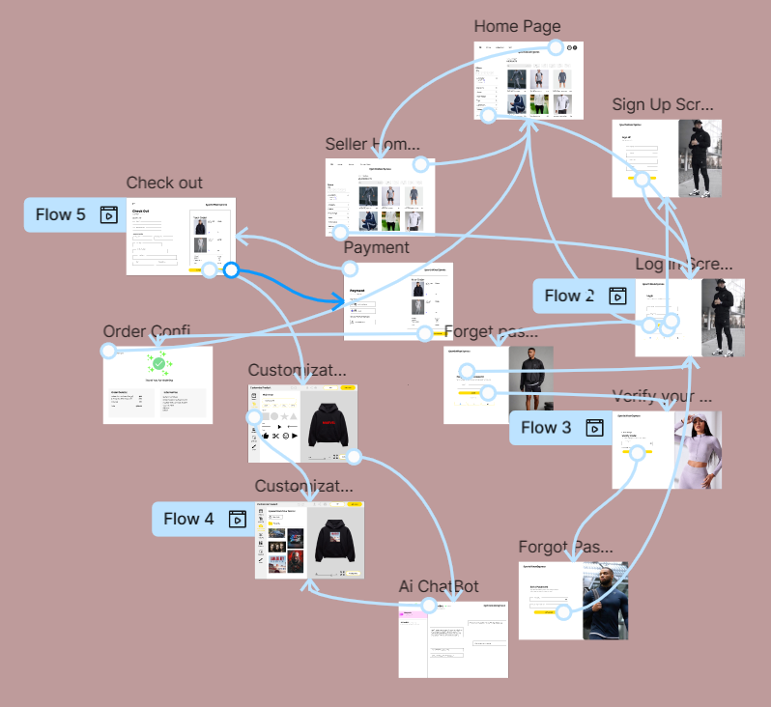
FLOW

Slide 34
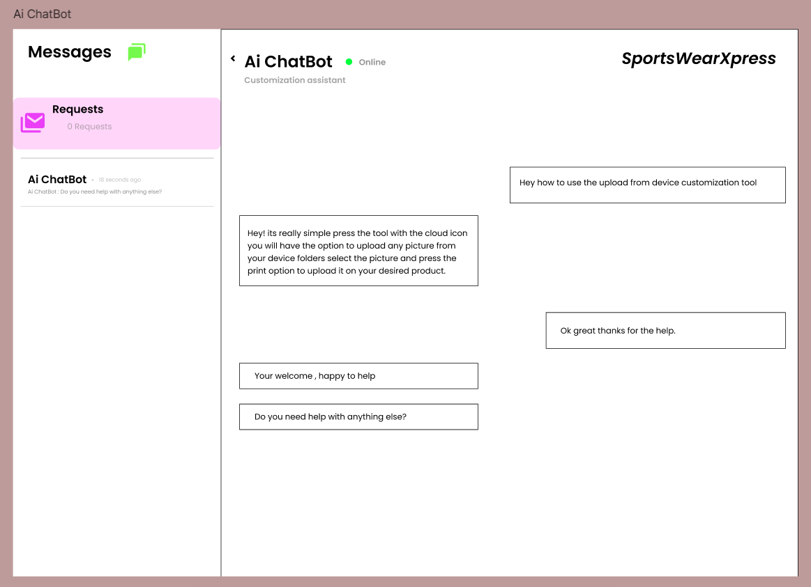
AI CHATBOT

Slide 35
RELATED PROJECTS
Custom Link
1
It enables custom apparel design but lacks advanced AI and seamless e-commerce integration.
Zazzle
2
Provides customization, but lacks AI and real-time communication.
Teespring
3
Offers basic custom design tools but lacks advanced AI and robust communication features.
SportWearXpress

Slide 36
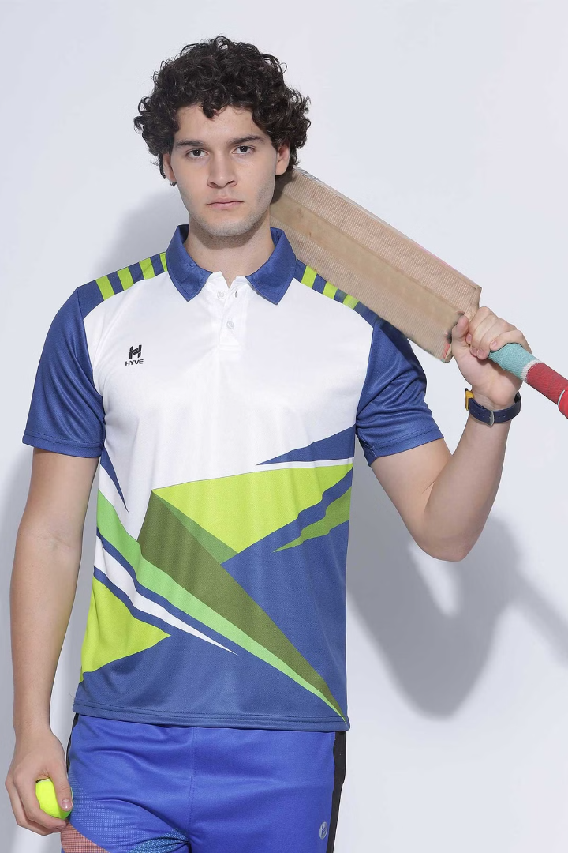
Conclusion
SportswearXpress uses AI to make sportswear customization easier and more efficient. With intelligent design tools, automated pricing, and real-time communication, users can create precise designs and interact seamlessly with sellers. This innovation improves user experience, reduces errors, and streamlines the entire customization process, setting a new standard in the industry.
SportWearXpress

